Slide 1
Analyzing Housing Data

Slide 2
Housing Data
For this project, I decided to look at some simple housing data to improve my EDA skills
The question I am asking is “What variable is the best predictor for price?”

Slide 3
Variables Chosen
What they mean
Price
Area
Number of Bedrooms
Number of Bathrooms
Number of Stories
The price the house sold for
Amount of square footage in the house
How many bedrooms there are
How many bathrooms there are
How many stories the house has

Slide 4
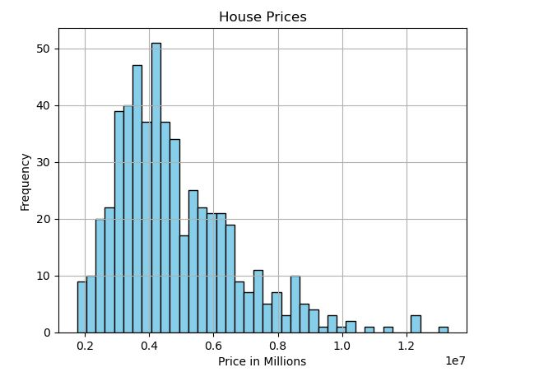
House Prices Histogram
There are two outliers just after 1.2 million but I think they should be included in the analysis because they are not extreme.
Mean: 476,672
The mode of the variable price is: 350,000
The spread of the variable price is: $100,000 to $1.4 million
The tail trails off to the right.

Slide 5
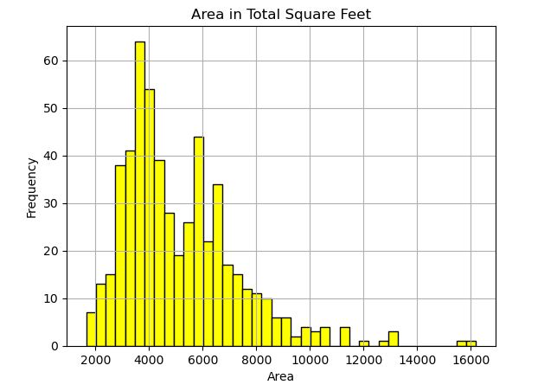
Area Histogram
There are two outliers around 16000 square feet. I think they should be included because they are not extreme.
Mean: 5,150 sq ft
Mode: 6,000
Spread: 1,800 to 16,000
The tail trails off to the right

Slide 6
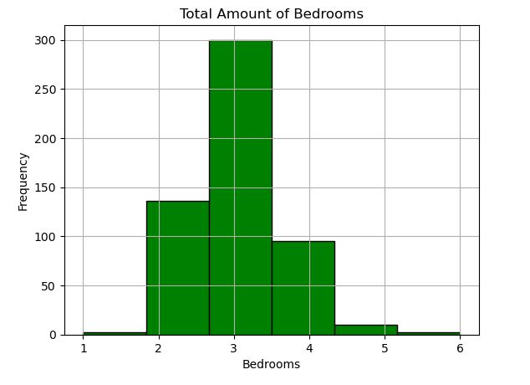
Bedrooms Histogram
No outliers here but you will notice that there are very few 1, 5, and 6 bedrooms houses.
Mean: 3
Mode: 3
Spread: 1 to 6
The tail trails a little to the right

Slide 7
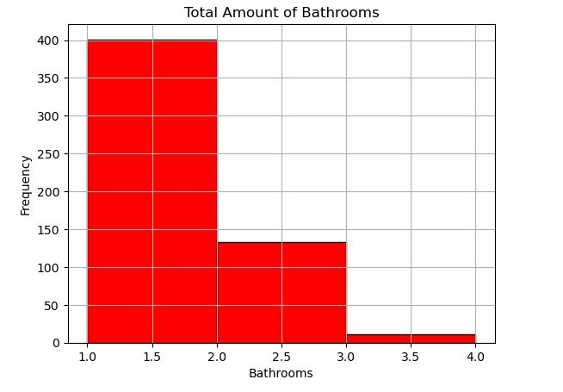
Bathrooms Histogram
No outliers here but you will notice that there are very few houses with 3, 3.5, and 4 bathrooms
Mean: 1.2
Mode: 1
Spread: 1 to 4
The tail trails off to the right

Slide 8
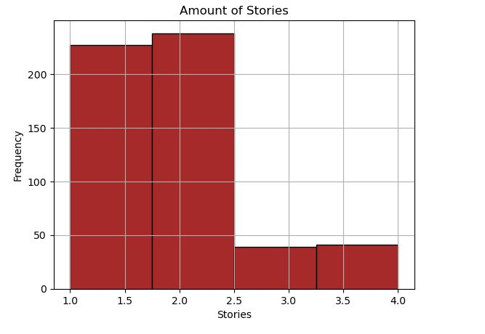
Bathrooms Histogram
No outliers here but there are fewer 3 and 4 story houses than 1 and 2.
Mean: 1.8
Mode: 2
Spread: 1 to 4
The tail trails off to the right

Slide 9
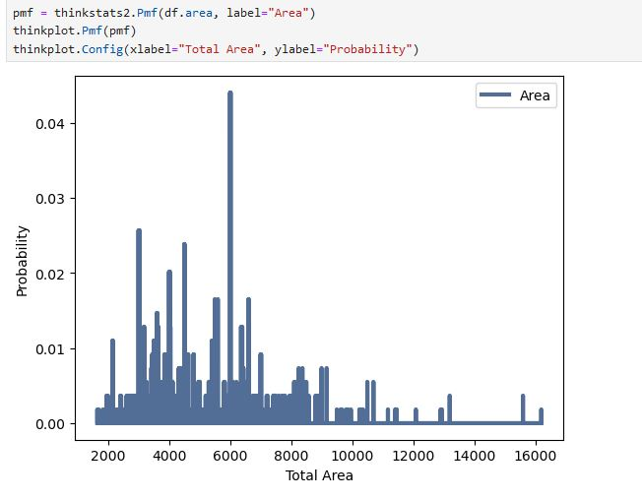
PMF for Area
I decided to do a PMF for the area. I ended up with something that looks similar to the histogram. It is different because it shows that 6000 square feet is the most likely to show up, which is also the mode so that makes sense.

Slide 10
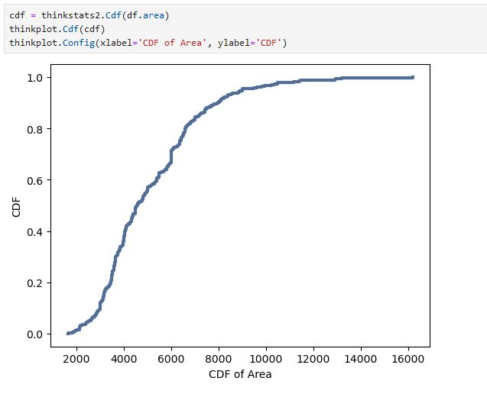
CDF for Area
The CDF of the area in each house tells us that the distribution is not normal. It would be more of an S shape if it was normally distributed. This means that most of the houses are 6000 square feet or more.

Slide 11
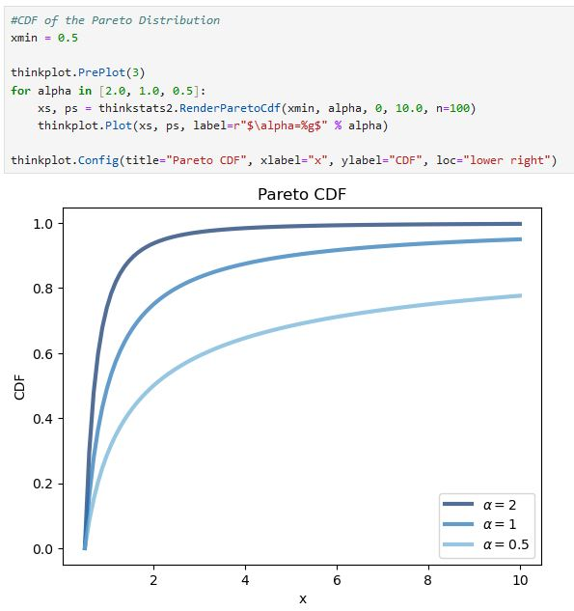
Pareto Distribution
This is a graph of a Pareto Distribution. Notice how the a=1 line is similar to our CDF of the area! This means that roughly 80% of the houses have larger square footage than the rest of the houses.

Slide 12
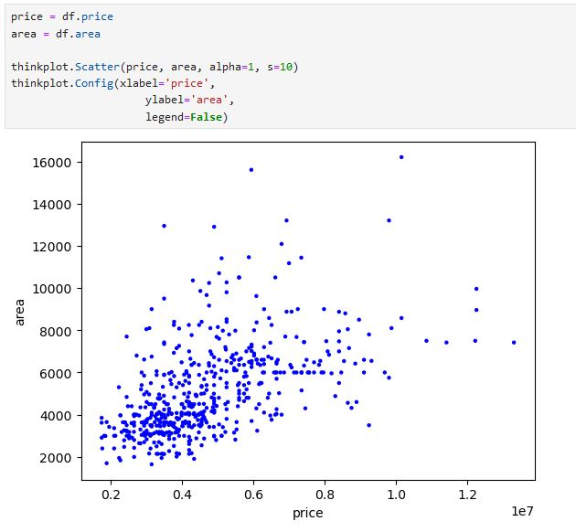
Scatterplot of Price and Area
This is a scatterplot of the price and area. Notice how there is a concentration at .4 mil and 4000 sq ft. This shows that they are not very strongly correlated so more square footage does not automatically equal a higher price.

Slide 13
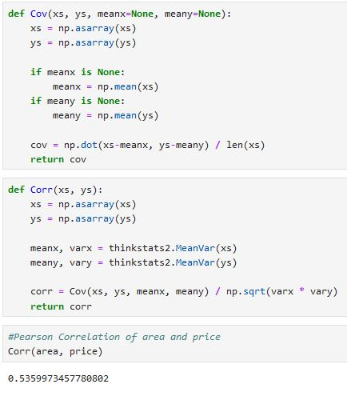
Pearson Correlation Test
The Pearson Correlation being .5 means that they have a positive relation but not a very strong relationship. Looking at the scatterplot, you can see that there are many houses at the same square footage with low and high prices. This lead me to believe that area is not a strong predictor of price and that there is instead something else not in this data that is a stronger predictor.

Slide 14
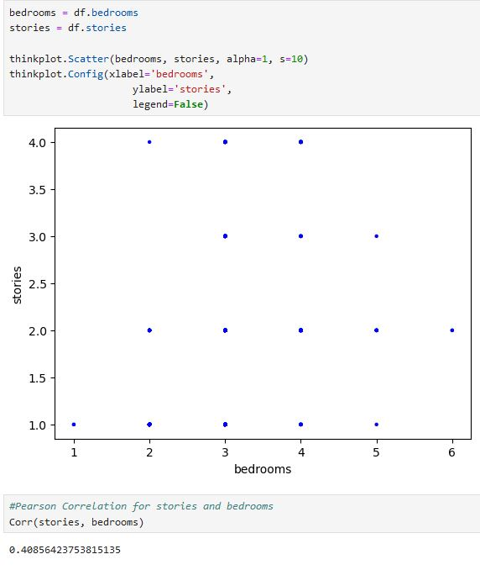
Scatterplot for Stories and Bedrooms
This is a pretty uninteresting scatterplot as the data is not very granular but it interesting that this shows that the number of stories does not always equal more rooms. The Pearson Correlation test of .4 shows that they have a positive but weak relationship.

Slide 15
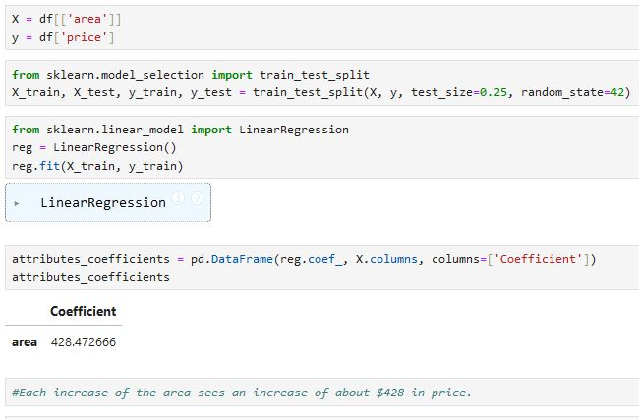
Regression Modeling
Here is the start of fitting a regression model to see if area is a good indicator for price. This model shows that each increase of price sees an increase of $428 in price.

Slide 16
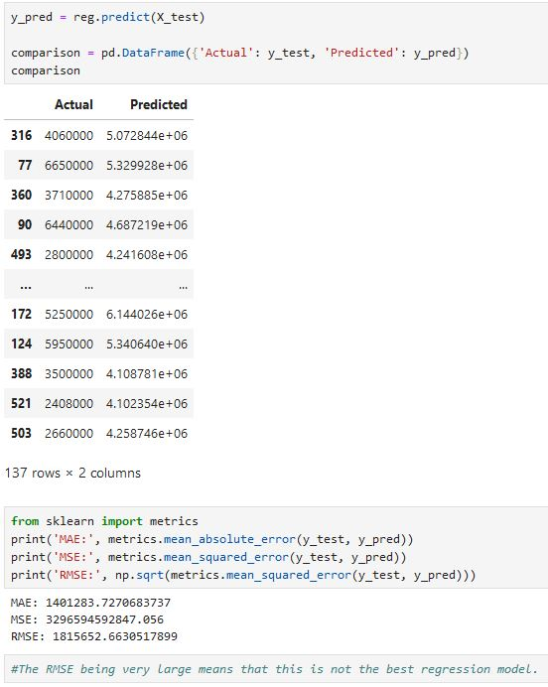
Regression Modeling cont.
Judging the the RMSE being such a high number, this model is not a good fit. It also shows that the area of a house is not a good predictor for the price. There must be other data that would be a better indicator such as location.

